Slide 1
Industrial Revolution - Social Studies
Here is where your presentation begins

Slide 2
Contents of this template
You can delete this slide when you’re done editing the presentation
Fonts | To view this template correctly in PowerPoint, download and install the fonts we used
Used and alternative resources | An assortment of graphic resources that are suitable for use in this presentation
Thanks slide | You must keep it so that proper credits for our design are given
Colors | All the colors used in this presentation
Icons and infographic resources | These can be used in the template, and their size and color can be edited
Editable presentation theme | You can edit the master slides easily. For more info, click here
For more info: Slidesgo | Blog | FAQs
You can visit our sister projects: Freepik | Flaticon | Storyset | Wepik | Videvo

Slide 3
Table of contents
01
02
03
04
Background and causes
Demographic revolution
You can describe the topic of the section here
You can describe the topic of the section here
Industrial economy
Impact and consequences
You can describe the topic of the section here
You can describe the topic of the section here

Slide 4
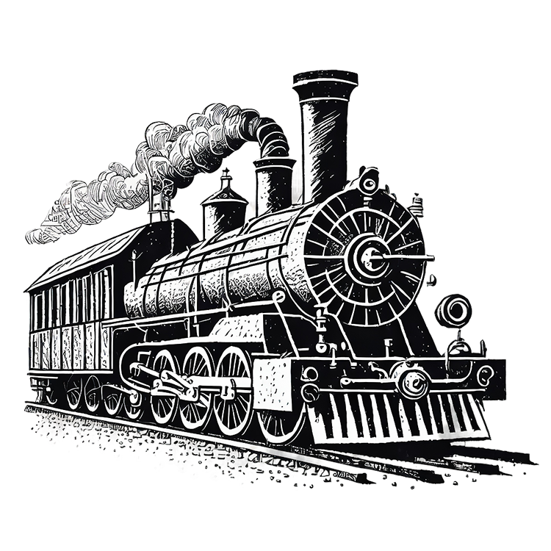
Whoa!
This can be the part of the presentation where you introduce yourself, write your email…

Slide 5
Introduction
Mercury is the closest planet to the Sun and the smallest one in the Solar System—it’s only a bit larger than the Moon. The planet’s name has nothing to do with the liquid metal, since Mercury was named after the Roman messenger god

Slide 6
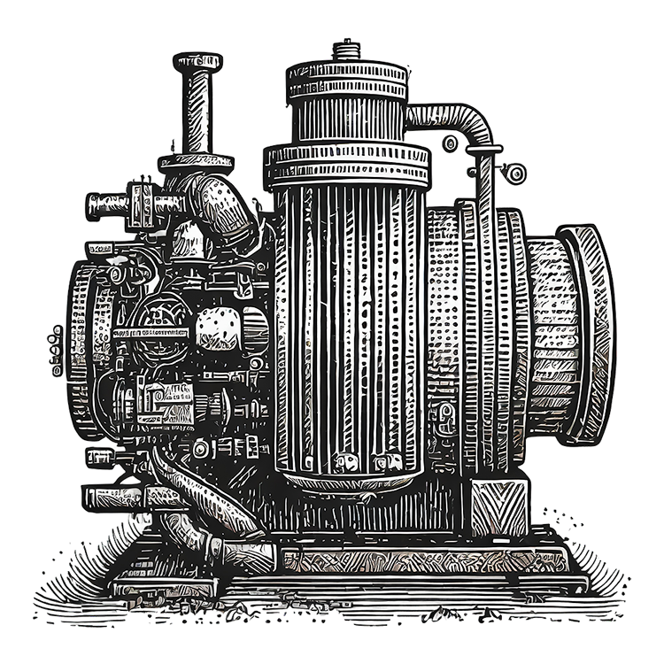
01
Background and causes
You can enter a subtitle here if you need it

Slide 7
Phases of the industrial revolution:
Mercury is the closest planet to the Sun and the smallest one in the entire Solar System. Contrary to popular belief, this planet's name has nothing to do with the liquid metal. Mercury was, instead, named after the famous Roman messenger god Mercurius
Mercury takes a little more than 58 days to complete its rotation, so try to imagine how long days must be there! Since the temperatures are so extreme, albeit not as extreme as on Venus, Mercury has been deemed to be non-habitable for humans

Slide 8
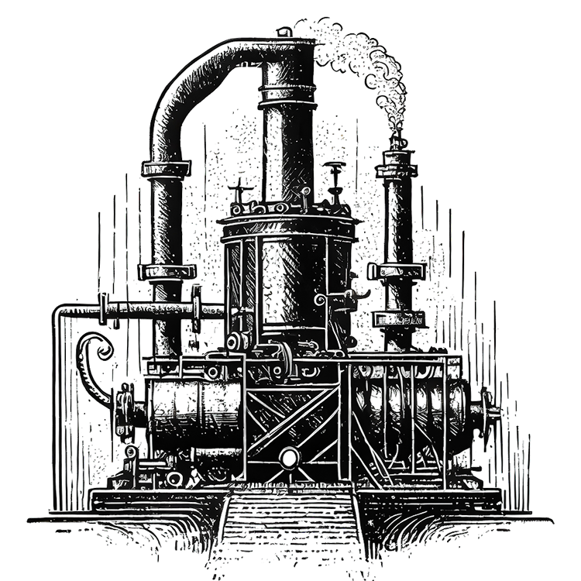
Background of the industrial revolution
Do you know what helps you make your point crystal clear? Lists like this one:
They’re simple
You can organize your ideas clearly
You’ll never forget to buy milk!
And the most important thing: the audience won’t miss the point of your presentation

Slide 9
Technological innovations
Mercury
Venus
Mercury is the closest planet to the Sun and the smallest one in the Solar System—it’s only a bit larger than the Moon
Venus has a beautiful name and is the second planet from the Sun. It’s hot and has a poisonous atmosphere

Slide 10
Transformations in production
Mercury
Venus
Mars
Mercury is the closest planet to the Sun and the smallest of them all
Venus has a beautiful name and is the second planet from the Sun
Despite being red, Mars is actually a cold place. It’s full of iron oxide dust

Slide 11
Economic consequences
Mars
Venus
Mars is actually a very cold place
Venus has extremely high temperatures
Jupiter
Saturn
Jupiter is the biggest planet of them all
Saturn is a gas giant and has several rings

Slide 12
Social consequences
Mars
Venus
Neptune
Mars is actually a very cold place
Venus has extremely high temperatures
Neptune is the farthest planet from the Sun
Mercury
Saturn
Jupiter
Mercury is the closest planet to the Sun
Saturn is a gas giant and has several rings
Jupiter is the biggest planet of them all

Slide 13
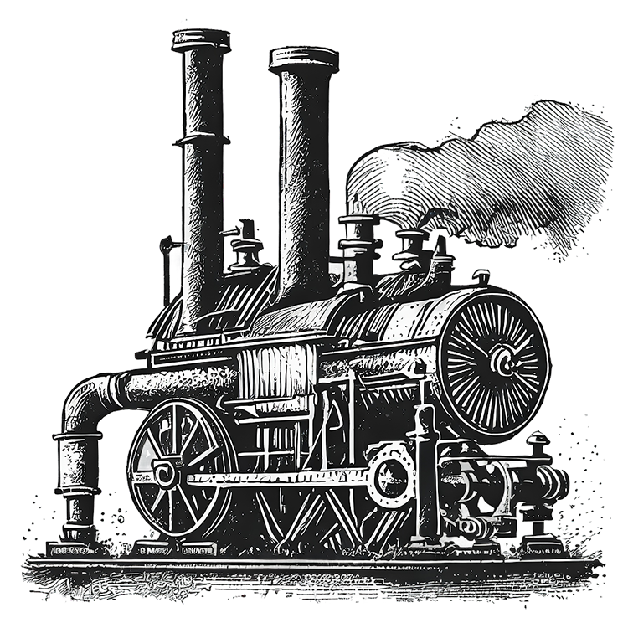
A picture always reinforces
the concept
Images reveal large amounts of data, so remember: use an image instead of a long text. Your audience will appreciate it

Slide 14
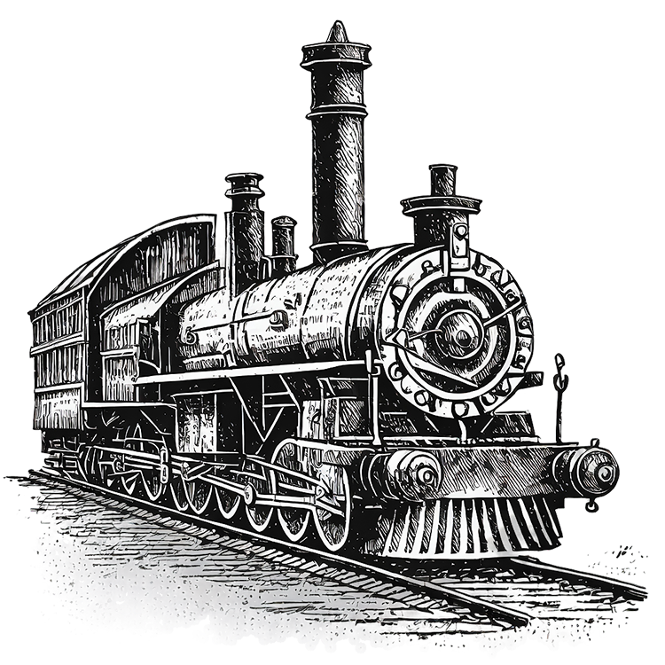
9h 55m 23s
333,000
386,000 km
Jupiter’s rotation period
The Sun’s mass compared to Earth’s
Distance between Earth and the Moon

Slide 15
Changes in living conditions
25%
50%
75%
Mercury
Venus
Mars
Mercury is the closest planet to the Sun and the smallest of them all
Venus has a beautiful name and is the second planet from the Sun
Despite being red, Mars is actually a cold place. It’s full of iron oxide dust

Slide 16
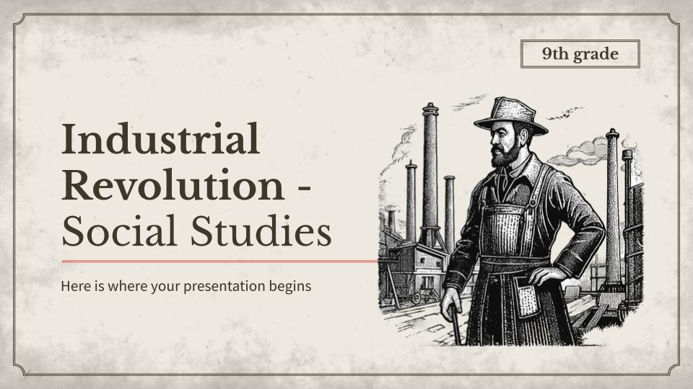
Computer mockup
You can replace the image on the screen with your own work. Just right-click on it and select “Replace image”

Slide 17
Urbanization and migration to cities
Mars
Despite being red, Mars is actually a cold place. It’s full of iron oxide dust

Slide 18
Revolutions and political changes
Mercury
Mars
Mercury is the closest planet to the Sun
Despite being red, Mars is actually a cold place
01
02
03
04
Venus
Saturn
Venus has a beautiful name, but it’s very hot
It has a high number of moons, like Jupiter

Slide 19
Cultural innovations
Mercury
Jupiter
Mercury is the closest planet to the Sun
Jupiter is the biggest planet of them all
Earth
Venus
Earth is also known as the blue planet
Venus has extremely high temperatures
Neptune
Moon
Neptune is very far away from the Sun
The Moon is Earth’s only natural satellite

Slide 20
Challenges and related criticisms
 | Description | Impact
Labor conditions | Child labor, long working hours, low wages, lack of job security | Poor health of workers, social unrest
Environmental impact | Air and water pollution, deforestation, depletion of natural resources | Damage to human health, species extinction, climate change
Social inequalities | Increase in the gap between rich and poor, rural displacement, lack of access to education and basic services | Social tensions, economic conflicts, general discontent

Slide 21
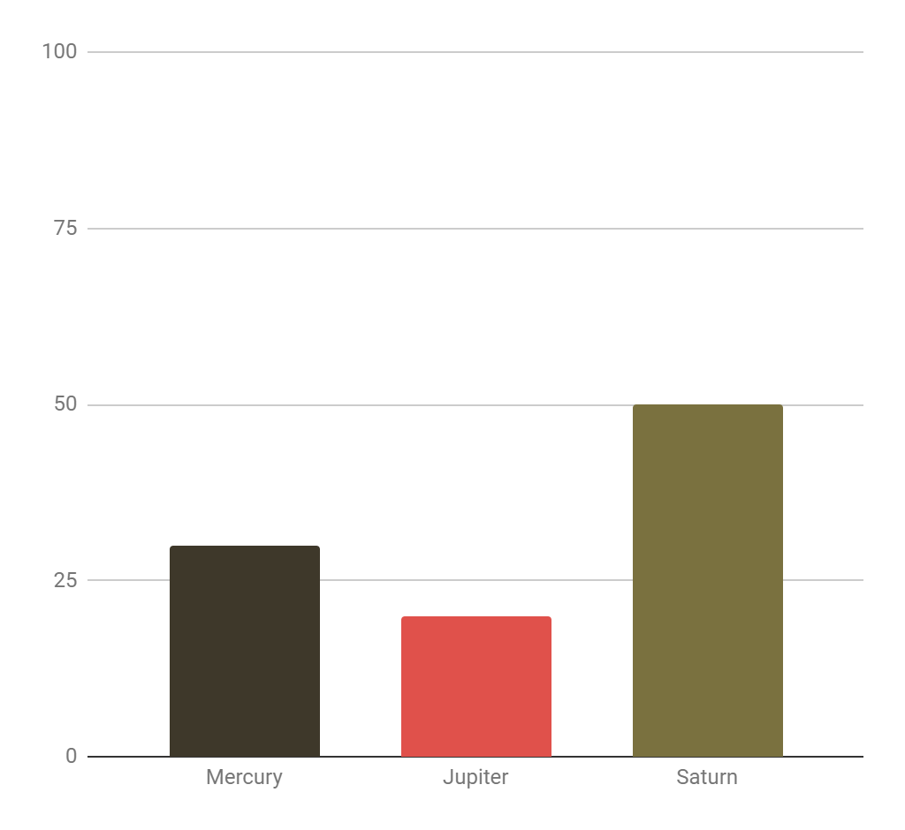
Impact on the environment
Mercury
30%
Jupiter
20%
Saturn
50%
Mercury is quite a small planet
Jupiter is an enormous planet
Saturn is a gas giant with rings
Follow the link in the graph to modify its data and then paste the new one here. For more info, click here

Slide 22
Rubric for written evaluation
Criteria | Excellent | Appropriate | Needs improvement
Paraphrasing | Use your own words throughout your writing | Expresses his own words in much of his writing | Expresses own words with little or no writing
Information | All the information is varied and important in the writing | Much of the information is varied and important | Little or no information is varied and important
Conventions | Use capital letters, periods, commas and accents correctly | Use capital letters, periods, commas and accents in much of the text | Use capital letters, commas and accents in little or no part of the text

Slide 23
Multiple choice questions
Question 1
Which of the following factors was one of the main drivers of the Industrial Revolution?
A) Political conservatism |  | B) Agrarian feudalism
C) Technological innovations |  | D) Rise of feudal trade
Question 2
What was one of the most significant social impacts of the Industrial Revolution?
A) Increase in agricultural production |  | B) Decrease in urbanization
C) Elevation of living conditions in cities |  | D) Mass migration to urban areas.

Slide 24
Short answer questions
Briefly describes in the following 3 sections the impact of the Industrial Revolution on the living conditions of the urban population.
Section 1
Section 2
Section 3

Slide 25
Exercise: Innovation design
Design an imaginary invention that improved life in the Industrial Revolution.
Instructions:
Imagine a problem of the time.
Create a simple invention to solve it.
Write a description of the invention: max. 12 words.
Make a drawing to represent the invention, with the technique that you best handle.
Share in class: benefits and how it changes lives.
This exercise encourages creativity and understanding of the needs during the Industrial Revolution by testing everything previously learned. Enjoy innovating!

Slide 26
Innovations in the 19th century
Essay on Technological Innovations in the 19th Century
01
02
03
Student Prompt
Lifestyle
Present
Examine how the technological innovations of the Industrial Revolution impacted 19th century society
Describe how these innovations changed the way people lived and worked day to day
Write about the Industrial Revolution, how it currently impacts modern society, its advantages and cons

Slide 27
Relationship between the revolutions
Relationship between the Industrial Revolution and the French Revolution
Industrial Revolution
French Revolution
You can write a feature here
You can write a feature here
You can write a feature here
You can write a feature here
You can write a feature here
You can write a feature here
You can write a feature here
You can write a feature here
You can write a feature here
You can write a feature here
You can write a feature here
You can write a feature here
You can write a feature here
You can write a feature here

Slide 28
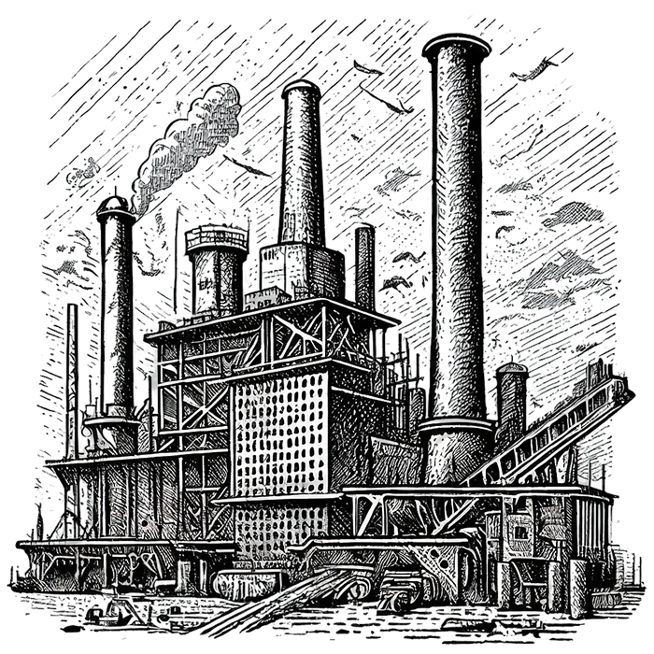
Thanks!
Do you have any questions?
youremail@freepik.com
+34 654 321 432
yourwebsite.com
Please keep this slide for attribution

